Slide 1
MODULE 3

Slide 2
What Is a Deployment Pipeline?
A deployment pipeline is an automated manifestation of the process for getting software from version control into the hands of your users.
Process involves building the software, followed by the progress of these builds through multiple stages of testing and deployment

Slide 3
What Is a Deployment Pipeline?
The input to the pipeline is a particular revision in version control.
Every change creates a build that will, pass through a sequence of tests .
This process of a sequence of test stages, each evaluating the build from a different perspective, is begun with every commit to the version control system

Slide 4
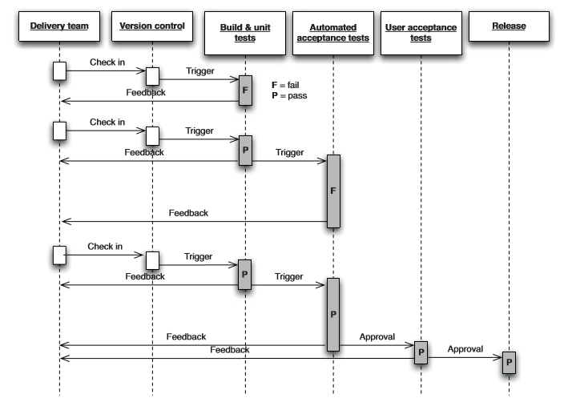
Changes moving through the deployment pipeline

Slide 5
As the build passes conﬁdence in it increases.
Environments the build passes through become progressively more production like.
Any build that fails a stage in the process will not generally be promoted to the next.

Slide 6
Consequences of applying this pattern(Previous figure deployment pipeline)
Prevented from releasing into production builds that are not thoroughly tested and found to be ﬁt for their intended purpose.
When deployment and production release themselves are automated, they are rapid, repeatable, and reliable.

Slide 7
Stages of Deployment Pipeline
1.The commit stage asserts that the system works at the technical level. It compiles, passes a suite of (primarily unit-level) automated tests, and runs code analysis.
2. Automated acceptance test stages assert that the system works at the functional and nonfunctional level, that behaviorally it meets the needs of its users and the speciﬁcations of the customer

Slide 8
3. Manual test stages assert that the system is usable and fulﬁlls its requirements, detect any defects not caught by automated tests, and verify that it provides value to its users. These stages might typically include exploratory testing environments, integration environments, and UAT (user acceptance testing).
4. Release stage delivers the system to users, either as packaged software or by deploying it into a production or staging environment (a staging environment is a testing environment identical to the production environment).

Slide 9
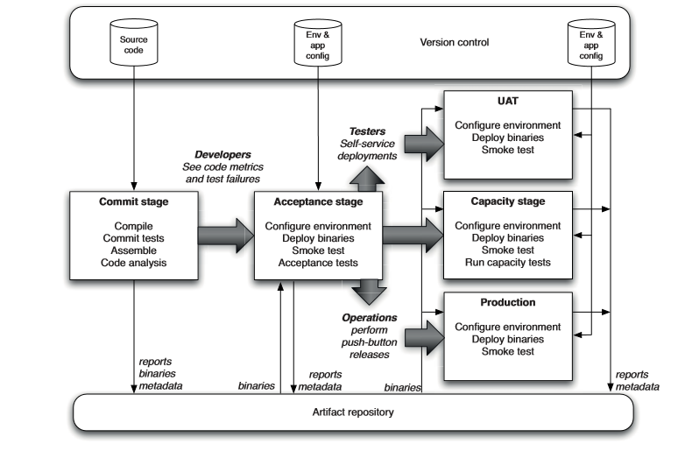
A Basic Deployment Pipeline

Slide 10
The process starts with the developers committing changes into their version control system.
The continuous integration management system responds to the commit by triggering a new instance of our pipeline.
The ﬁrst (commit) stage of the pipeline compiles the code, runs unit tests, performs code analysis, and creates installers.
If the unit tests is passed and the code is up to scratch, we assemble the executable code into binaries and store them in an artifact repository

Slide 11
Plenty of tools like Nexus and Artifactory helps to manage artifacts.
The second stage is automated acceptance tests.
CI server performs automatic tests suites which can be executed in parallel to increase their speed and give you feedback faster.
At this point, the pipeline branches to enable independent deployment of your build to various environments—in this case, UAT (user acceptance testing), capacity testing, and production

Slide 12
Deployment pipeline practises
Only Build Your Binaries Once
Collections of executable code are binaries.
Collections of source files. Jars, .NET assemblies, and .so files are all examples of binaries.
Build the binaries once, during the commit stage of the build. These binaries should be stored on a filesystem.

Slide 13
Deployment pipeline practises
Smoke-Test Your Deployments
There is an automated script that does a smoke test to make sure that it is up and running.
This could be as simple as launching the application and checking to make sure that the main screen comes up with the expected content.
The smoke test should also check that any services that the application depends on are up and running—such as a database, or external services.

Slide 14
Deployment pipeline practises
Each Change Should Propagate through the Pipeline Instantly
Somebody checks a change into version control, creating version 1in turn, triggers the first stage in the pipeline (build and unit tests).
This passes, and triggers the second stage: the automated acceptance tests. Somebody then checks in another change, creating version 2. This triggers the build and unit tests again.
Even though these have passed, they cannot trigger a new instance of the automated acceptance tests, since they are already running

Slide 15
In the meantime, two more check-ins have occurred in quick succession.
However, the CI system should not attempt to build both of them—
if it followed that rule, and developers continued to check in at the same rate, the builds would get further and further behind what the developers are currently doing.
Instead, once an instance of the build and unit tests has finished, the CI system checks to see if new changes are available, and if so, builds off the most recent set available—in this case, version 4.

Slide 16
Suppose this breaks the build and unit tests stage. The build system doesn’t know which commit, 3 or 4, caused the stage to break, but it is usually simple for the developers to work this out for themselves.
Some CI systems will let you run specified versions out of order, in which case the developers could trigger the first stage off revision 3 to see if it passes or fails, and thus whether it was commit 3 or 4 that broke the build.

Slide 17
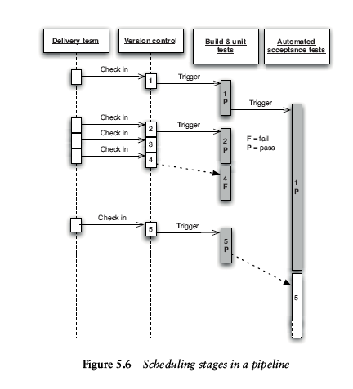

Slide 18
Deployment pipeline practises
If Any Part of the Pipeline Fails, Stop the Line
If a deployment to an environment fails, the whole team owns that failure.
They should stop and fix it before doing anything else.

Slide 19
Build and deployment scripting
An Overview of Build Tools
Build tools are programs that automate the creation of executable applications from source code(eg. .apk for android app).
Building incorporates compiling, linking and packaging the code into a usable or executable form.
Build automation utility (like Make, Rake, MS build, Ant, Gradle etc.)
Whose primary purpose is to generate build artifacts through activities like compiling and linking source code

Slide 20
Android SDK Build-Tools is a component of the Android SDK required for building Android apps. It's installed in the <sdk>/build-tools/ directory.
We always keep the Build Tools component updated by downloading the latest version using the Android SDK Manager.
By default, the Android SDK uses the most recent downloaded version of the Build Tools.
If your projects depend on older versions of the Build Tools, the SDK Manager allows you to download and maintain separate versions of the tools for use with those projects

Slide 21
An Overview of Build Tools
All build tools have a common core: Build tools allow to model a dependency network.
When you run your tool, it will calculate how to reach the goal you specify by executing tasks in the correct order, running each task that your goal depends on exactly on.
Build tool will perform every task in the dependency network

Slide 22
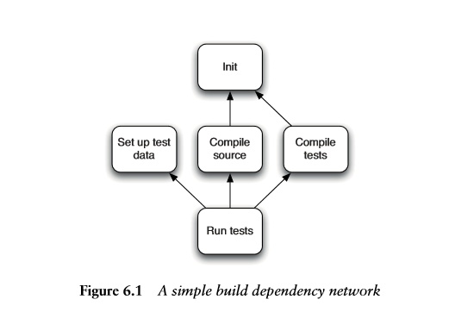

Slide 23
Build tools will walk the entire network, invoking (but not necessarily executing) each task.
It can start with either init or setting up test data, since these tasks are independent.
Once it has done init, it can then compile the source or the tests—but it must do both, and set up the test data, before the tests can be run.
A build tool must ensure that each prerequisite must be executed exactly once.

Slide 24
Test data is data which has been specifically identified for use in tests.
Some data may be used to verify that a given set of input to a given function produces some expected result.
Other data may be used in order to challenge the ability of the program to respond to unusual, extreme, exceptional, or unexpected input

Slide 25
Build tools are categorized into two:
Task-oriented build tools (for example, Ant, NAnt, and MsBuild) describe the dependency network in terms of a set of tasks.
In a task-oriented tool, each task will know whether or not it has already been executed as part of the build.
Thus, even though the Init task is invoked twice, it would only be executed once

Slide 26
Task-oriented build tools, in contrast, keep no state between builds.
This makes them less powerful and entirely unsuitable for compiling C++.
However, they work ﬁne for languages such as C# since the compilers for these languages have built-in logic for performing incremental builds.

Slide 27
A product-oriented tool, such as Make, describes things in terms of the products they generate, such as an executables.
The Compile source and Compile tests goals in our example would each result in a single ﬁle that contains all the compiled code— source.so and tests.so
A product-oriented build system would ensure it invoked Run tests after Compile source and Compile tests.

Slide 28
Product-oriented build tools thus keep their state in the form of timestamps on the ﬁles generated by each of the tasks.
In C or C++ Make build tool will ensure that we only compile those source code ﬁles that have changed since the last time the build was run.

Slide 29
This feature, known as an incremental build, can save hours over a clean build on large projects.
Compilation takes a comparatively long time in C/C++ because the compilers have to do a great deal of work optimizing the code.
Task-oriented build tools, in contrast, keep no state between builds. This makes them less powerful and entirely unsuitable for compiling C++.

Slide 30
Different types of build tools
Make
Make is a powerful product-oriented build tool capable of tracking dependencies within a build and building only those components that are affected by a particular change.
Makefile is a program building tool which runs on Unix, Linux, and their flavors. It aids in simplifying building program executables that may need various modules.
Make takes the help of user-defined makefiles for building.
Makefiles are special format files that help build and manage the projects automatically.

Slide 31
Final binary will be dependent on various source code and source header files.
Dependencies are important because they let the make Known about the source for any target. Consider the following example −
hello: main.o factorial.o hello.o
$(CC) main.o factorial.o hello.o -o hello
Here, we tell the make that hello is dependent on main.o, factorial.o, and hello.o files.
Hence, whenever there is a change in any of these object files, make will take action

Slide 32
Different types of build tools
Ant
Ant is a task-oriented build tool. The runtime components of Ant are written in Java.
Ant includes a set of tasks written in Java to perform common operations such as compilation and ﬁlesystem manipulation.
Ant Create Specific folder structure and Compile all java programs

Slide 33
Different types of build tools
NAnt and MSBuild
When Microsoft ﬁrst introduced the .NET framework, it had many features in common with the Java language and environment.
Java developers who worked on this new platform quickly ported some of their favorite open source Java tools.
So instead of JUnit and JMock we have NUnit and NMock—and NAnt. NAnt uses essentially the same syntax as Ant, with only a few differences

Slide 34
Microsoft later introduced their own minor variation on NAnt and called it MSBuild.
It is a direct descendant of Ant and Nant.
It is used in Visual Studio, to build Visual Studio solutions and projects and manage dependencies

Slide 35
Different types of build tools
Maven
Maven is a software project management and comprehension tool.
Used to handle enterprise level Java projects development.
Maven support for automated management of Java libraries and dependencies between projects

Slide 36
Maven simplifies and standardizes the project build process. It handles compilation, distribution, documentation, team collaboration etc.
Maven increases reusability and takes care of most of build related tasks.
Developers do not have to mention each and every configuration detail. Maven provides sensible default behavior for projects.

Slide 37
Different types of build tools
Rake
Rake was developed by Ruby programmers and is widely used for Ruby projects
Ruby build tool,
Rake scripts are plain Ruby.
Rake tasks are also used for building .NET systems

Slide 38
Different types of build tools
The new generation build tools, are Buildr, Gradle, and Gantt.
It uses the same conventions that Maven does, including filesystem layout, artifact specifications, and repositories

Slide 39
Principles and Practices of Build and Deployment Scripting
The deployment pipeline is essentially the path to deploy your code to production reliably
Each stage in deployment pipeline consists of a set of commands that are run to accomplish a specific purpose
Create a Script for Each Stage in Your Deployment Pipeline
Commit script - containing all the targets required to compile your application, package it, run the commit test suite, and perform static analysis of the code.

Slide 40
Functional acceptance test script that calls your deployment tool to deploy the application to the appropriate environment, then prepares any data, and finally runs the acceptance tests.
Nonfunctional tests scripts that run non functional test such as stress tests or security tests.

Slide 41
Principles and Practices of Build and Deployment Scripting
Use an Appropriate Technology to Deploy Your Application
In deployment pipeline, most stages such as the automated acceptance test stage and user acceptance test stage after commit stage, depend upon the application being deployed to a production-like environment
Deployment is automated . We should use the right tool for the job when automating deployment

Slide 42
WebSphere Application Server, use the Wsadmin tool to conﬁgure the container and deploy the application.
WebSphere Application Server is a software framework that hosts Java based web applications.
The Wsadmin tool can be used to execute scripts written in Jacl and Jython, .
These scripts and commands perform administrative tasks like application deployment, configuration changes and run-time monitoring and control of IBM WAS.

Slide 43
Principles and Practices of Build and Deployment Scripting
The deployment script should cover the case of upgrading your application
Use the Same Scripts to Deploy to Every Environment
Use the same process(using the same scripts) to deploy to every environment in which your application runs to ensure that the build and deployment process is tested effectively

Slide 44
Every environment is different in some way.
Operating system and middleware configuration settings, the location of databases and external services, and other configuration information that needs to be set at deployment time.
This does not mean you should use a different deployment script for every environment. Instead, keep the settings that are unique for each environment separate.
One way to do this is to use properties files to hold configuration information.

Slide 45
You can have a separate properties file for each environment.
These files should be checked in to version control, and the correct one is selected

Slide 46
Principles and Practices of Build and Deployment Scripting
Use Your Operating System’s Packaging Tools
There are a bunch of files( created by the build process), and libraries that your application requires.
Deploying a bunch of files that need to be distributed across the filesystem is very inefficient
Packaging systems were invented to bundle up everything that needs to be deployed.

Slide 47
Debian and Ubuntu both use the Debian package system; RedHat, and many other flavors of Linux use the RedHat package system;
Windows users can use the Microsoft Installer system

Slide 48
Ensure the Deployment Process Is Idempotent
Your deployment process should always leave the target environment in the same (correct) state.

Slide 49
Evolve Your Deployment System Incrementally
You don’t have to have completed all of the steps to get value from your work
Start by getting the operations team to work with developers to automate deployment of the application into a testing environment.
Make sure that the operations people are comfortable with the tools being used to deploy.

Slide 50
Commit stage
The commit stage begins with a commit to the version control system
It ends with either a report of failure or, if successful, a collection of binary artifacts
The commit stage is also the point at which you should begin the construction of your deployment pipeline

Slide 51
Commit stage
The commit stage includes the following task
Compiling (if necessary) and running the commit tests against the integrated source code
Creating binaries that can be deployed into any environment.
Performing any analysis necessary to check the health of the codebase.
Creating any other artifacts (such as test data) that will be used later in the deployment pipeline

Slide 52
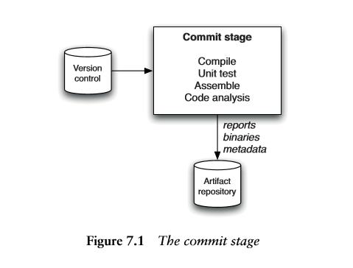

Slide 53
These tasks are performed by build scripts that are run by your continuous integration server.
For developers, the commit stage is the most important feedback cycle in the development process.
The result of the commit stage represents a signiﬁcant event in the life of every release candidate

Slide 54
Commit stage principles and practices
Provide Fast, Useful Feedback
Failures in the commit tests can be due to three causes:
Either a syntax error has been introduced into the code, caught by compilation in compiled languages;
or a semantic error has been introduced into the application, causing one or more tests to fail;
or there is a problem with the conﬁguration of the application or its environment (including the operating system).

Slide 55
Commit stage principles and practices
In case of failures, the commit stage should notify the developers as soon as the commit tests are complete and provide a summary of the reasons for the failures, such as a list of failed tests, the compile errors, or any other error conditions.
Errors are easiest to ﬁx if they are detected early.

Slide 56
Commit stage principles and practices
What Should Break the Commit Stage?
The commit stage is designed to fail in one of the circumstances listed above:
Compilation fails, tests break, or there is an environmental problem.
Otherwise, the commit stage succeeds, reporting that everything is OK

Slide 57
But consider the situation if the tests pass but the quality of the code is bad.
It should be possible to provide a set of graphs representing code coverage and other metrics, upon completion of a commit stage run.
This information could be aggregated using a series of thresholds into a trafﬁc lights display (red, amber, green) .

Slide 58
We could, for example, fail the commit stage if the code coverage drops below 60%, and have it pass but with the status of amber, not green, if it goes below 80%.
if the commit stage fails, the rule is that the delivery team must immediately stop whatever they are doing and ﬁx it

Slide 59
Commit stage principles and practices
Tend the Commit Stage Carefully
The commit stage will include both build scripts and scripts to run unit tests, static analysis tools etc. These scripts need to be maintained carefully and treated with the same level of respect as you would treat any other part of your application
Ensure that your scripts are modular.
Structure them so as to keep common tasks, used all the time but rarely changing, separate from the tasks that you will be changing often, such as adding a new module to your codebase

Slide 60
Commit stage principles and practices
Give Developers Ownership
Developers and operations people must feel comfortable with, and responsible for, the maintenance of their build system.
At some organizations, there are teams of specialists who are experts at the creation of effective, modular build pipelines.
This kind of activity should not be done by a build specialist
The management of the environments such as adding new libraries, conﬁguration ﬁles, and so on, should be performed by developers and operations people working together

Slide 61
Commit stage principles and practices
Use a Build Master for Very Large Teams
In small teams of up to twenty or thirty individuals, If the build is broken, it is usually easy enough to locate the person or persons responsible and either remind them of the fact if they are not working on it
In larger teams, it is useful to have someone to play the role of a “build master.”
Their job is to oversee and direct the maintenance of the build, but also to encourage and enforce build discipline

Slide 62
If a build breaks, the build master notices and reminds of the team to ﬁx the build quickly or back out their changes.
The build master should never be a permanent role.
Team members should rotate through it, on a weekly basis

Slide 63
The result of commit stage
The commit stage, like every stage in the deployment pipeline, has both inputs and outputs.
The inputs are source code, and the outputs are binaries and reports.
The reports produced include the test results, which are essential to work out what went wrong if the tests fail, and reports from analysis of the codebase.

Slide 64
Analysis reports can include things like test coverage, cut and paste analysis, and any other useful metrics that help establish the health of the codebase

Slide 65
The result of commit stage
The Artifact Repository
Most modern continuous integration servers provide an artifact repository, including settings which allow unwanted artifacts to be removed after some length of time
Alternatively, we could use a dedicated artifact repository like Nexus, or some other Maven-style repository manager, to handle.

Slide 66
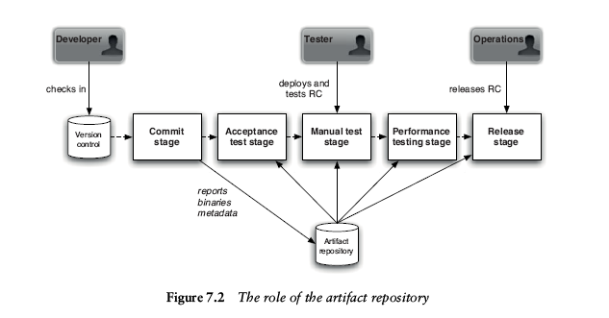
Figure shows a diagram of the use of an artifact repository in a typical installation

Slide 67
The following details each step in the happy path of a release candidate that makes it successfully into production
1. Somebody on your delivery team commits a change.
2. Your continuous integration server runs the commit stage.
3. On successful completion, the binary as well as any reports and metadata are saved to the artifact repository.

Slide 68
4. Your CI server then retrieves the binaries created by the commit stage and deploys to a production-like test environment.
5. Your continuous integration server then runs the acceptance tests, reusing the binaries created by the commit stage.
6. On successful completion, the release candidate is marked as having passed the acceptance tests

Slide 69
7. Testers can obtain a list of all builds that have passed the acceptance tests, and can press a button to run the automated process to deploy them into a manual testing environment.
8. Testers perform manual testing.
9. On successful conclusion of manual testing, testers update the status of the release candidate to indicate it has passed manual testing.

Slide 70
10. Your CI server retrieves the latest candidate that has passed acceptance
testing, or manual testing depending on the pipeline configuration, from the
artifact repository and deploys the application to the production test
environment.
11. The capacity tests are run against the release candidate.
12. If successful, the status of the candidate is updated to “capacity-tested.”

Slide 71
13. This pattern is repeated for as many stages as the pipeline requires.
14. Once the RC has passed through all of the relevant stages, it is “ready for
release,” and can be released by anybody with the appropriate authorization,
usually a combination of sign-off by QA and operations people.
15. At the conclusion of the release process, the RC is marked as “released.”

Slide 72
Commit test suite principles and practices
The most important property of unit tests is that they should be very fast to execute. Sometimes we fail the build if the suite isn’t sufficiently fast.
The second important property is that they should cover a large proportion of the codebase (around 80% is a good rule of thumb), giving you a good level of confidence that when they pass, the application is fairly likely to be working.

Slide 73
Commit test suite principles and practices
Mike Cohn has a good way of visualizing how we should structure our automated test suite

Slide 74
Commit test suite principles and practices
Avoid the User Interface
For the purposes of commit tests, it is not recommended to test via the UI
The difficulty with UI testing is twofold.
First, it involves a lot of components or levels of the software under test.
Second, UIs are designed to work at human timescales which, compared to computer timescales, are desperately slow.

Slide 75
Avoid the Database
The unit tests that form the bulk of your commit tests should never rely on the database.
To achieve this, we should be able to separate the code under test from its storage. This requires good layering in the code.

Slide 76
Using Test Doubles
The ideal unit tests are focused on a small, closely related number of code
components, typically a single class or a few closely related classes.
The use of test doubles are very effective in this case.

Slide 77
Brute Force
Developers will always argue for the fastest commit cycle.
This need must be balanced with the commit stage’s ability to identify the most common errors that you are likely to introduce.

Slide 78
This is an optimization process that can only work through trial and error.
Sometimes, it is better to accept a slower commit stage than to spend too much time optimizing the tests for speed or reducing the proportion of bugs they catch.
Modern CI servers have “build grid” functionality that makes easy test execution
Example:selenium grid on jenkins

